Slide 1


4TH INTERNATIONAL CONFERENCE ON ROBOTICS, CONTROL, AUTOMATION AND ARTIFICIAL INTELLIGENCE 2025
190
Classification of Retinal Diseases based on Optical Coherence Tomography Images using Transfer Learning
Shaivi Rutvij Panchal, Reva Sameer Laghate, Omkar S Powar
Department of Biomedical Engineering, Manipal Institute of Technology, Manipal Academy of Higher Education, Manipal, Karnataka, India - 576104
1

Slide 2
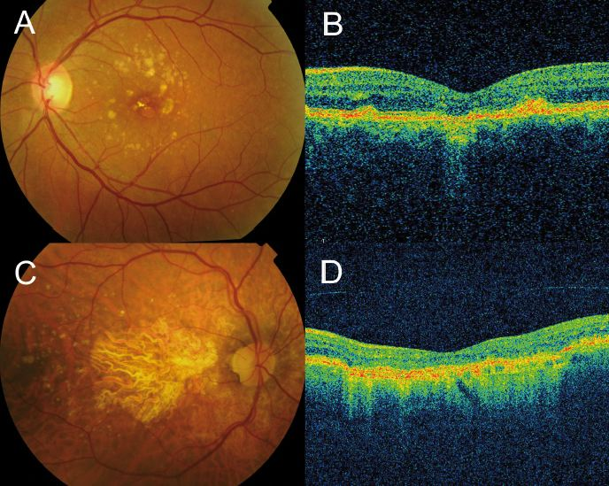
TABLE OF CONTENTS
Introduction
Literature Review
Problem Statement
Objectives
Methodology
Result & Discussion
Conclusion
References
2

Slide 3
INTRODUCTION
Age-related Macular Degeneration (AMD) and Diabetic Macular Edema (DME) are major causes of vision loss, especially in individuals over 65 and those with diabetes.
AMD affects the macula, leading to central vision loss, and occurs in two forms: dry (90%), linked with drusen deposits, and wet, involving choroidal neovascularization (CNV).
DME arises from retinal fluid accumulation caused by prolonged hyperglycemia, commonly seen in diabetic retinopathy.
Optical Coherence Tomography (OCT) provides non-invasive, high-resolution cross-sectional imaging of retinal layers, enabling superior structural analysis.
Deep learning and transfer learning models (e.g., CNNs, InceptionV3, MobileNetV2) enhance automated OCT-based diagnosis, addressing limitations of manual interpretation and data scarcity.
3

Slide 4
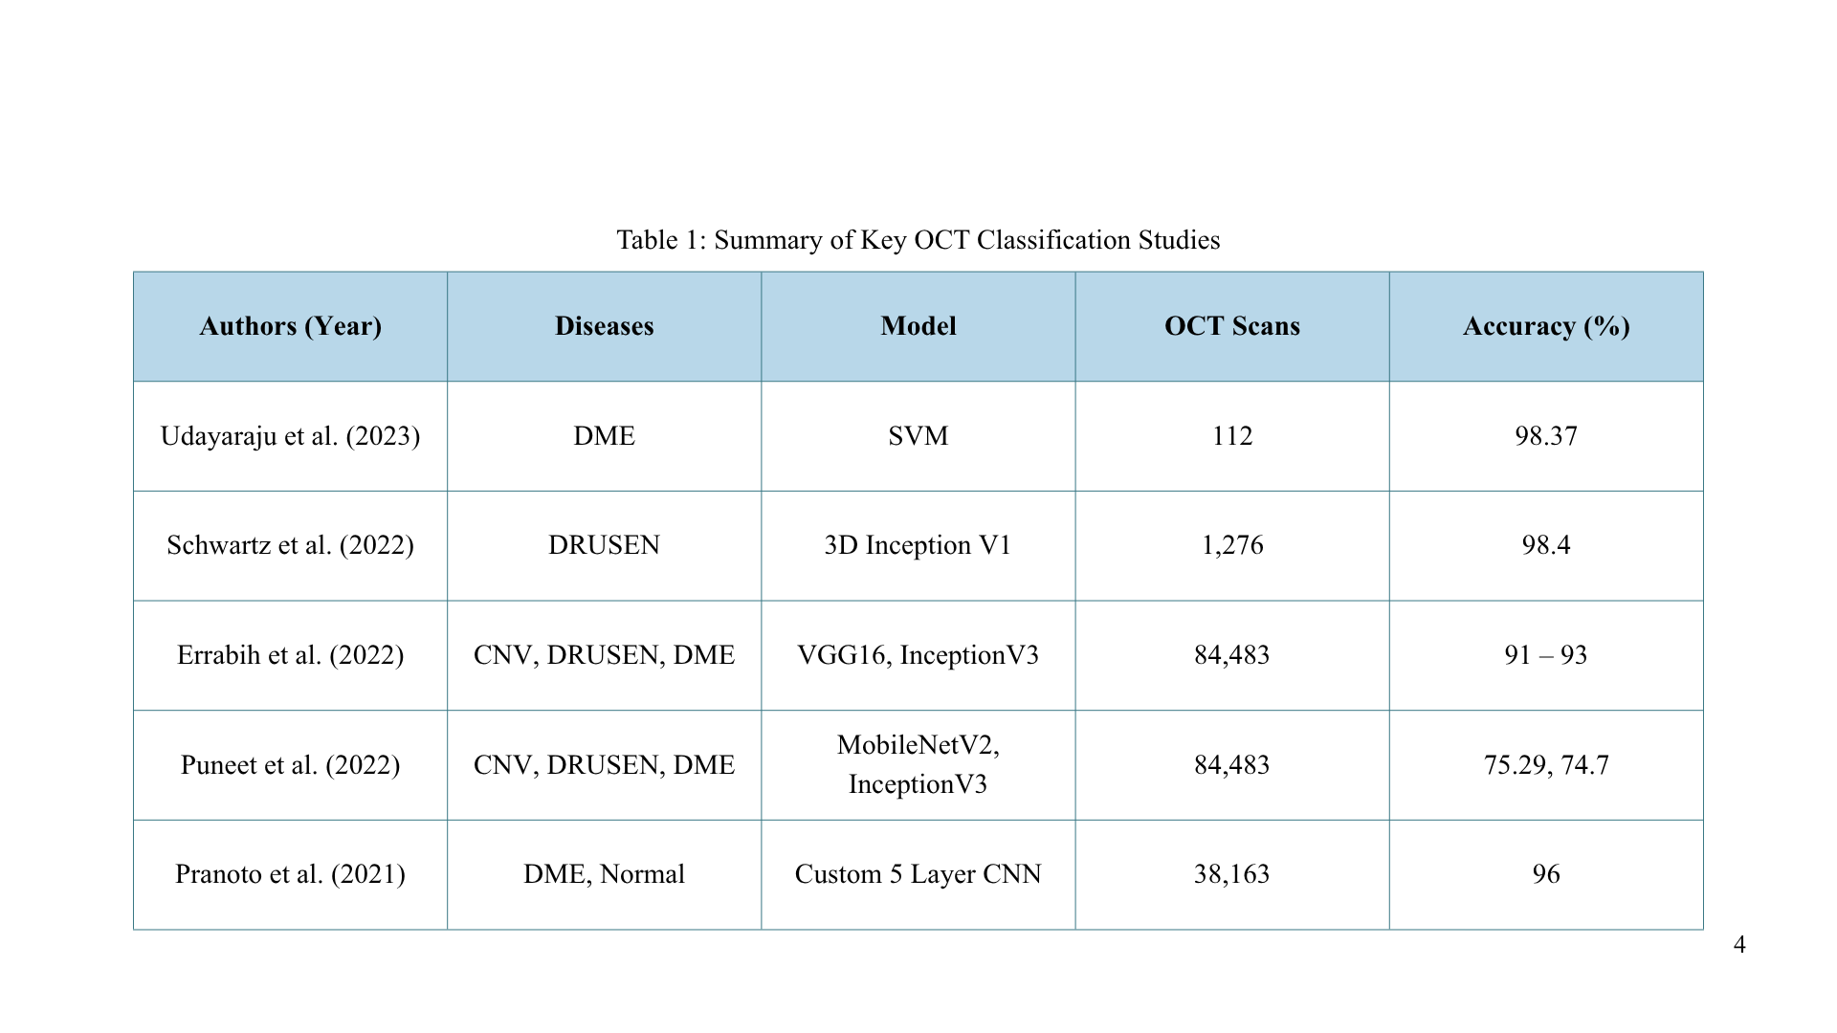
LITERATURE REVIEW
LITERATURE REVIEW

Slide 5
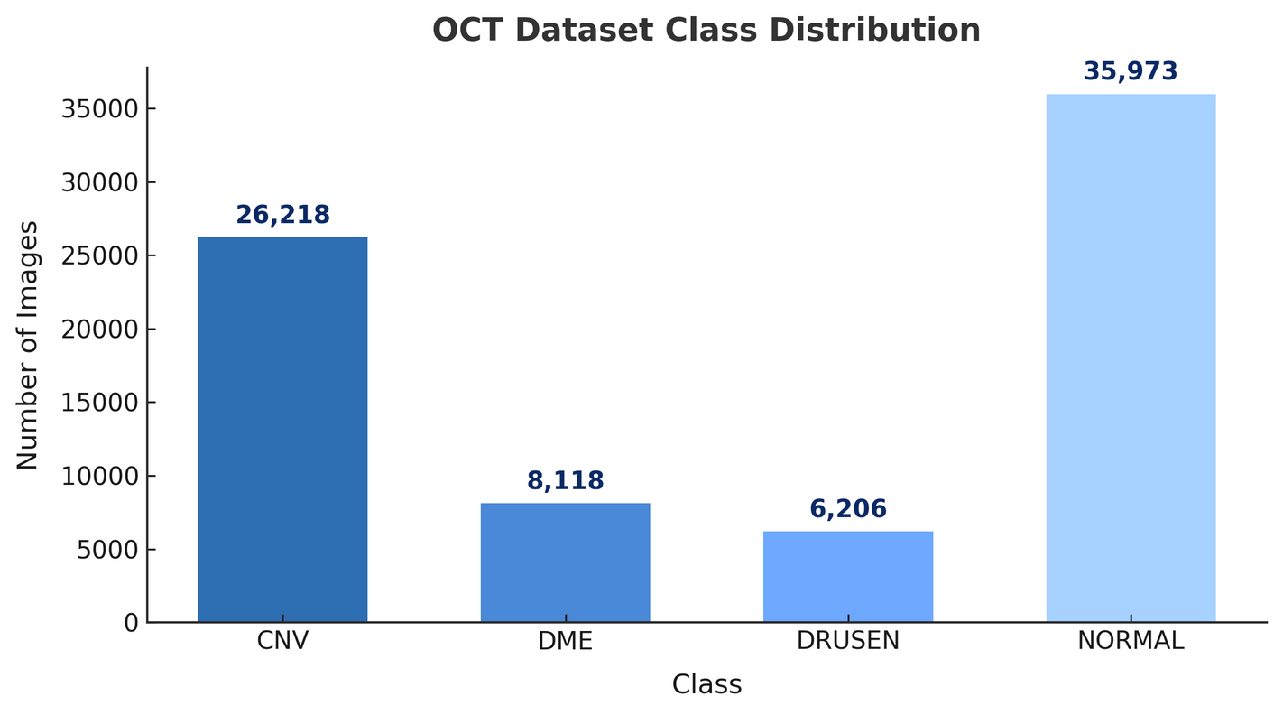
PROBLEM STATEMENT
Real world retinal imaging data exhibit significant class imbalance, highlighting the need for an optimized, well-evaluated deep learning model that ensures balanced, high-accuracy classification for automated ophthalmic diagnosis.
5
Figure 1: Distribution of Samples across the Retinal OCT Dataset Classes

Slide 6
OBJECTIVES
Transfer Learning
Class Imbalance
To develop a transfer learning–based deep learning model using InceptionV3 and MobileNetV2 for accurate and automated classification of retinal diseases from OCT images.
To address real-world class imbalance through class weighting and data augmentation, ensuring balanced performance and reliable detection across all retinal disease categories.
6

Slide 7
METHODOLOGY
DATASET
Kermany et al. (2018) OCT dataset with four classes: CNV, DME, DRUSEN, NORMAL
PRE-
PROCESSING
Grayscale conversion
Resize 224×224
Data Augmentation
Normalization [0–1]
EVALUATION METRICS
Accuracy, Precision and Recall, AUC, Confusion matrix
MODEL ARCHITECTURE
InceptionV3 & MobileNetV2
Flatten, Dense layers with early stopping
DATASET DETAILS
Images Distribution: CNV(26,218), DME(8,118), DRUSEN(6,206), NORMAL(35,973)
Train Val Test Split: 7:2:1
7

Slide 8
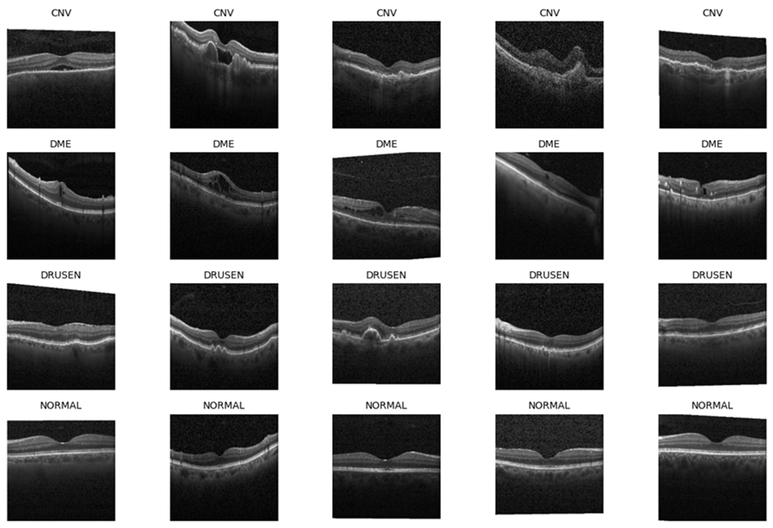
METHODOLOGY
8
Figure 2: Representation of Samples across the Retinal OCT Dataset Classes: CNV, DME, DRUSEN, and NORMAL

Slide 9

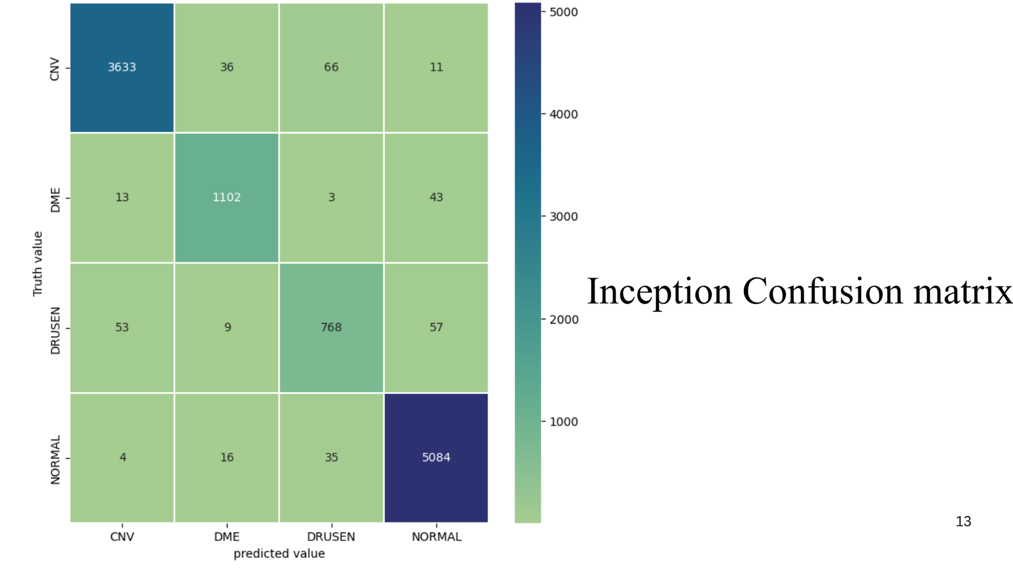
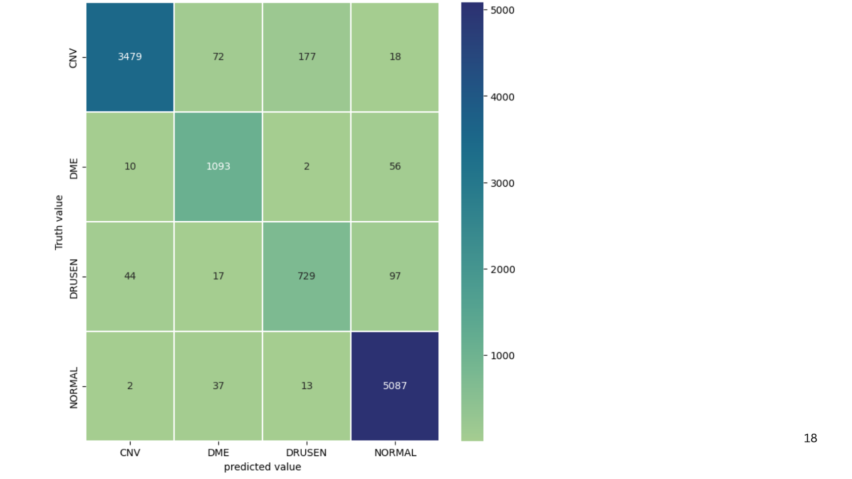
RESULT AND DISCUSSION
9
Figure 3: Multi-Class Confusion Matrix by InceptionV3
Figure 4: Multi-Class Confusion Matrix by MobileNetV2

Slide 10

RESULT AND DISCUSSION
InceptionV3
MobileNetV2
Training accuracy:
0.90 → 0.98+
Validation accuracy:
0.94 → 0.97
Training accuracy:
0.88 → 0.97
Validation accuracy:
0.90 → 0.96
96.83%
95.05%
Smooth and consistent accuracy curves indicate excellent generalization with minimal risk of overfitting.
Slight fluctuations, but overall stable and high-performing model.
CNV: 97%
DME: 94.9%
NORMAL: 98.9% DRUSEN: 86.6%
CNV: 92.9%
DME: 94.1%
NORMAL: 99% DRUSEN: 82.2%
10

Slide 11
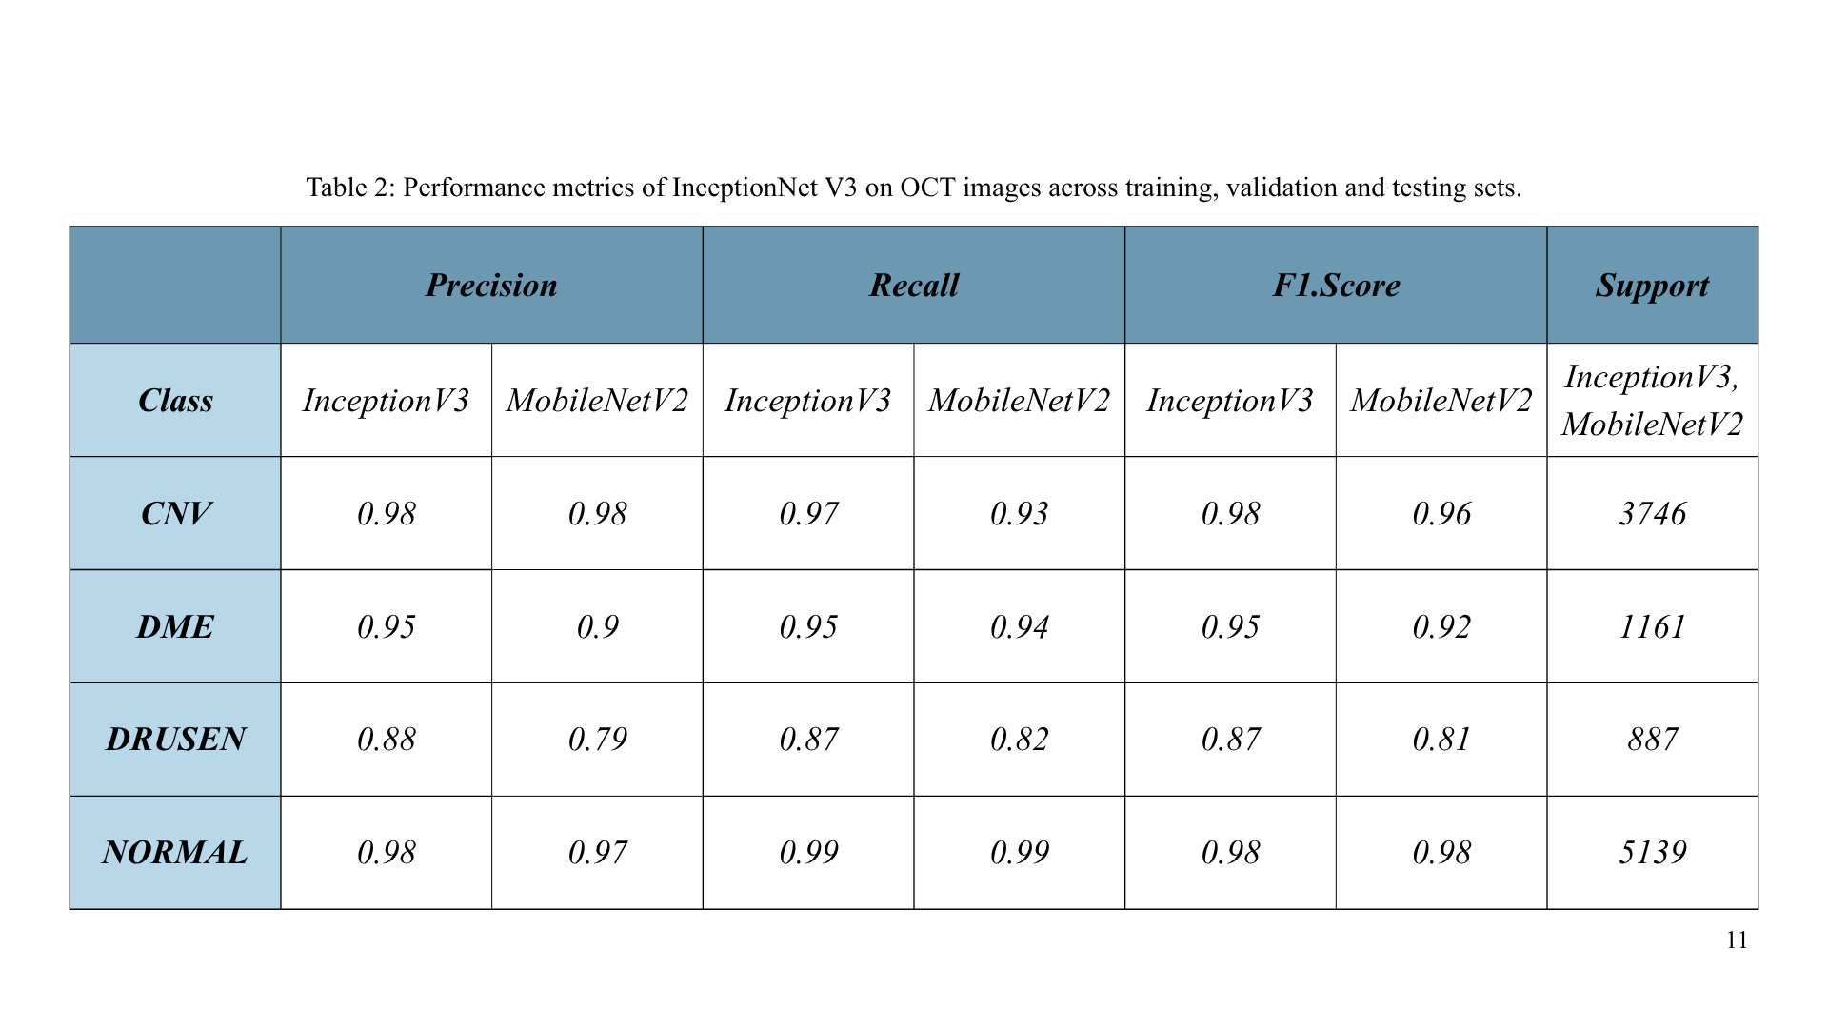
INTRODUCTION
RESULT AND DISCUSSION
Table 1: Summary of Key OCT Classification Studies
4

Slide 12
REFERENCES
Kermany, D. S., Goldbaum, M., Cai, W., Valentim, C. C., Liang, H., Baxter, S. L., ... & Zhang, K. (2018). Identifying medical diagnoses and treatable diseases by image-based deep learning. cell, 172(5), 1122-1131.
Errabih, A., Boussarhane, M., Nsiri, B., Sadiq, A., Alaoui, M. H. E. Y., Thami, R. O. H., & Benaji, B. (2022). Identifying Retinal Diseases on OCT Image Based on Deep Learning. Int. J. Online Biomed. Eng., 18(15), 141-159.
Puneet, K., & Gupta, M. (2022). Optical coherence tomography image-based eye disease detection using deep convolutional neural network. Health Information Science and Systems, 10(13).
Pranoto, S., Hidayat, H., Sudarsono, S., & Lukman, M. P. (2021, April). Detection of diabetic macular edema in optical coherence tomography image using convolutional neural network. In Proceedings of the 1st International Conference on Electronics, Biomedical Engineering, and Health Informatics: ICEBEHI 2020, 8-9 October, Surabaya, Indonesia (pp. 659-666). Singapore: Springer Singapore.
12

Slide 13
Thank You
13

